Slide 1
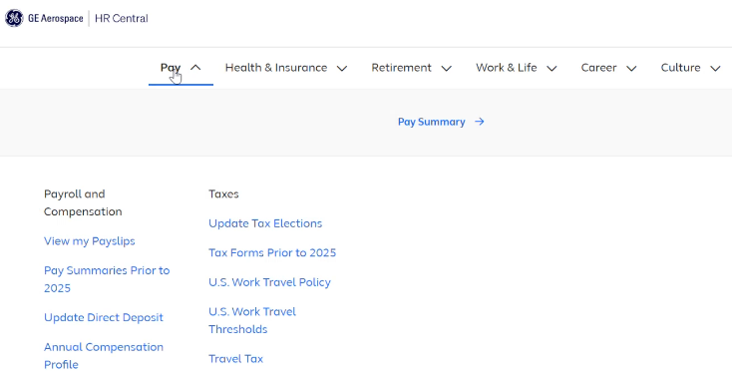
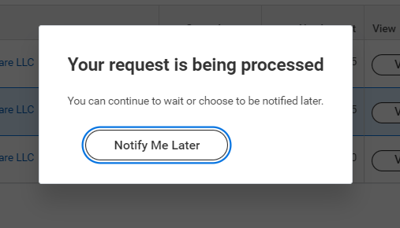
Find your pay information
U.S. Hourly and Salaried employees
Go to: hrcentral.geaerospace.com
1
2
To see high-level details (gross and net) of latest pay: Click: Pay > Pay Summary
3
To see full details: Click: View my Payslips (takes you to Workday)
6
4
5
You can also go straight to workday.geaerospace.com
To view the PDF, click “Print” (even if you don’t want to print)
Do you have a question or a pay issue?
Click “Notify me Later”
Go to HR Central and click Contact Us to live chat or submit a request. Or contact HR Services at: 1-844-477-2200
Find the pay slip at the notification bell

